Slide 1
Investing in Career Opportunities for Youths with Disabilities Joe Ashley & Bob Schmidt

Slide 2
Employment Challenges
29.5 million working-age people had a disability in 2010 – that’s 16.6% of the working-age population
Individuals with disabilities face employment challenges
In 2010,
41% employment rate for individuals with a disability vs. 79% of those without a disability
Median monthly income for people with a disability was about $1961, or about 28% lower than for those without a disability

Slide 3
Vocational Rehabilitation
VR started after WW I for returning veterans with physical disabilities
Extended to civilian population and a broad array of disabilities
Focus is on employment and earnings
VR is Title IV of Workforce Innovation and Opportunity Act
Eligibility-based: Documented disability that constitutes impediment to employment and individual can benefit from services
Cost sharing between state and federal government
In Virginia: DARS is general agency; DBVI serves individuals who are blind or vision impaired
Individualized plans for employment
Staff and community partners provide many services

Slide 4
Focus Tonight
VR serves the full age range and a broad array of disabilities
Cognitive, emotional, physical, vision, hearing, substance abuse
Tonight, focus on PERT
A program for transitioning youth from high school to work
52% of participants have an intellectual disability or a specific learning disability
Rises to 80% when add autism and ADHD

Slide 5
What is PERT?
Postsecondary Education Rehabilitation and Transition
PERT is a collaborative effort between the Virginia Department for Aging and Rehabilitative Services and the Virginia Department of Education.
PERT provides
Vocational, IL and Residential/Leisure assessment
Transition planning
Trial vocational training opportunities

Slide 6
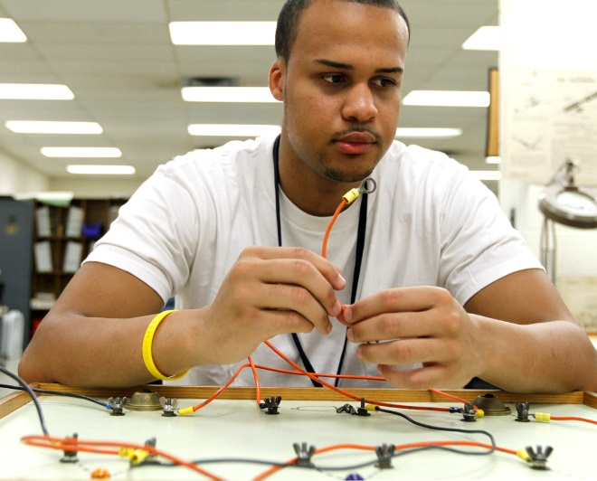
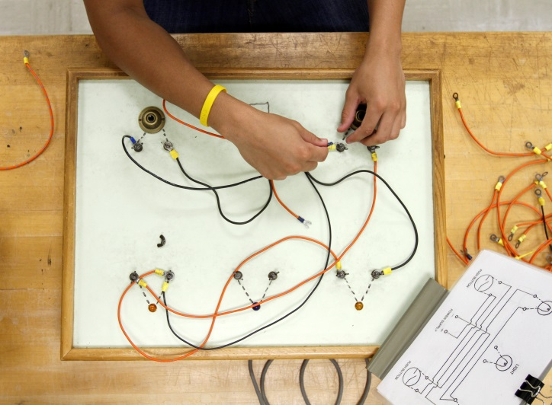
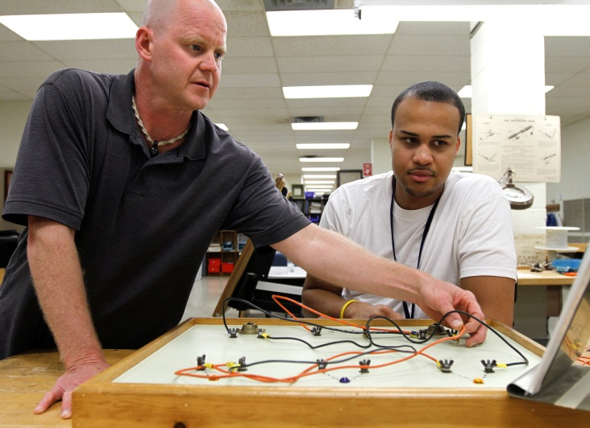
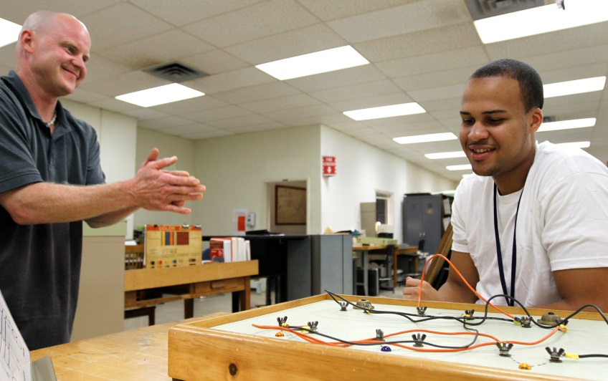
PERT 10-Day Residential Assessment

Slide 7
The “ideal” PERT Student
Age 16 or 2.5 years from high school graduation (actual ages range from 15½ to almost 22 years).
The student must have a disability and be enrolled in special education or have a 504 plan and qualify for DARS services.
The student must be able to function safely in a residential campus environment with staff support.
The student must be medically, physically and psychologically stable.
Notes:
The student should have some potential of Competitive employment.

Slide 8
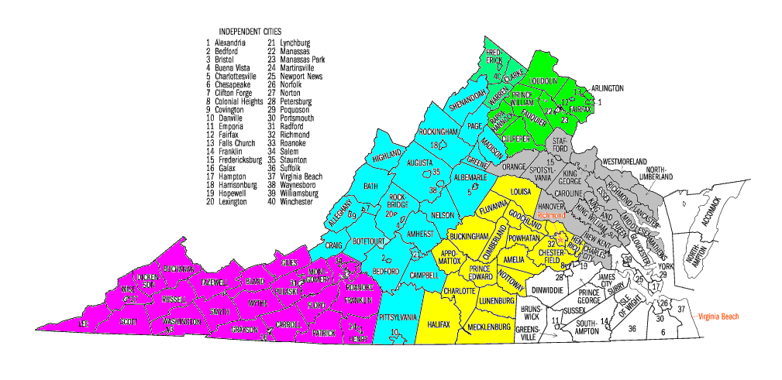
PERT: From inception to now
Inception in 1985: a federally-funded demonstration grant
50 students/year
6 local school divisions
Evolved into an integral component of school-to-work transition services for eligible secondary-aged youth with disabilities in the public school system.
500+ students/year
Statewide: up to to 132 local school divisions

Slide 9
Report Implementation
PERT Summary Report following 10-day in-residence assessment
Six weeks post exit
Student/Family, DARS counselor and the school
Report Implementation
At the student’s local school during remaining high school
Notes:
from Vocational Evaluation, Ancillary appointments, Residential and Independent Living Skills Assessment.

Slide 10
Follow-Up Programs
PERT Situational Assessment Program (SITS)
Ten day trial training
Approximately 60 students/year – summer and school year dates available
Disability, Academic or Interest issue
Some return to DARS for VR services

Slide 11
Impact for Student
PERT goals for the individual students
Improved understanding of disability and how to achieve goals
Strengthened IL applications at home and in community
Foster more interest in school and reduce early drop-out rate
Increases post-secondary training
Increases long term earning potential **(ROI clearly answers)

Slide 12
Value to PERT Partners
PERT impact goals for the school
Systemic Impact on Transition Planning – Local Level
Improved transition planning – early planning better than later (ROI)
Provides age appropriate transition services
Strengthens collaborative efforts with DARS
Parents and teachers often perceive increases in student self-esteem and self-advocacy

Slide 13
Rehabilitation Rate
Since 2009 the Rehab Rate for PERT Initial, PERT SIT (Life Skills or Training) and Training combinations is 78% which is exceptional.

Slide 14
Evaluating PERT

Slide 15
Evaluating PERT: Concepts
Q: How would circumstances change for a randomly-chosen person if complete a Workforce Program?
The Gold Standard: Randomized Clinical Trials
But …
Individuals in PERT are not a random sample; they self select. Plausibly, they might
Be more motivated
Have stronger family support
Be more severely disabled

Slide 16
Evaluating PERT: Compared to Whom?
Our earlier PERT analysis
Current VR-ROI research

Slide 17
A Comparison Group Approach to Assessing Labor Market Outcomes from PERT
Cohort: Applicants for DARS Services in SFY 1988
(Published in the VECAP Journal in 2006)

Slide 18
Quasi-Experimental Outcome Evaluation Framework
Compared to Whom? Examples of statistical alternatives to an experimental control group
Matched comparison group
Natural experiment when program is only available in selected areas or for selected populations
This study uses both

Slide 19
The Sample for the 1988 Study
Includes PERT & other VR participants under age 18 in a “natural experiment”
PERT participants matched on demographic and disability characteristics (only ID & LD) with DARS “business as usual” comparison group in same geographic school/planning district
91 in PERT “treatment group”, 142 in non-PERT “comparison group”

Slide 20
Long-Term Employment Data
State Unemployment Insurance records have quarterly data for people in “covered employment”
Study used quarterly earnings from the Virginia Employment Commission from 1985-2000
Includes 3 years pre-program (1985-1988) and 12 years post-program (1988-2000)
“Hit rate” of about 80% having at least one quarter of covered employment

Slide 21
Notes:
Chart 1, titled Earnings During the Year, if any shows average annual earnings in “real” 2002 dollars for the PERT participants versus the non-PERT comparison group receiving DRS “business as usual” services. Earnings are provided from the period three years prior to application for DRS/PERT services through 12 years post-application. Annual earnings for the comparison group dipped from $8,000 down to about $5,000 through the application period and then slowly increase to about $10,000 ten years after application. Meanwhile, earnings steadily increase for the PERT participants, starting at about $2,000 in the three years prior to application and then surpassing those of the non-participants (at $10,000) in the fifth post-application year and then continuing to rise, approaching $15,000 by the tenth post-application year.

Slide 22
Study Limitations
Matched comparison group controls for some observed characteristics but some differences remain unknown to the researchers
A blunt instrument
Looks only at overall PERT impacts
Says nothing about contributions of the component parts

Slide 23
A Structural-Equations Approach to Assessing PERT Labor Market Outcomes
Cohort: 3,073 15-24 year-old applicants for DARS services in SFY 2000
(under review at the Journal of Labor Economics)

Slide 24
The Sample for the 2000 Study
Focus is on transitioning youth who
Applied for VR services during FY 2000
Were age 15-24 at application
Were diagnosed with an ID, LD, and/or MI
Sample composition
 | PERT | Not PERT | Total
VR Services | 199 | 1,774 | 1,973
No VR Services | 195 | 905 | 1,100
Total | 394 | 2,679 | 3,073

Slide 25
Potential Ways for PERT to Affect Labor Market Outcomes
PERT May Affect the Efficiency of DARS Services on Employment Outcomes
PERT May Affect the Efficiency of Remaining School Time on Employment Outcomes
PERT Services Alone May Directly Affect Employment Outcomes
Notes:
There are three potential ways for PERT to affect labor market outcomes: 1) PERT may directly affect employment outcomes.; 2) PERT may affect the efficiency of the remaining time in school as it impacts on employment outcomes; and 3) PERT may also affect the efficiency of subsequent VR services which then impact on employment outcomes.

Slide 26
The Econometric Model
Allows estimation of the three separate impacts
Uses a rich set of variables, including
Quarterly earnings from 1997-2010
Demographics (age, gender, ethnicity, education, locale, etc.)
Any or all disabilities
Service receipt (if any) for 6 distinct types of VR services
Uses state-of-the-science statistical techniques to bring our “comparison groups” closer to “randomized control groups”

Slide 27
An Economist’s View of PERT Effectiveness
Rate of Return (ROR) on the $3,500 cost of the PERT Evaluation
Over a 5-year period: 95.3% have positive ROR with median ROR of 72% annually
Over a 10-year period: 99.3% have positive ROR with median ROR of 79% annually
Alternatively, on an “investment” of $3,500 in PERT, a PERT consumer earns $2,600 more annually ($13,000 over 5 years) than a non-PERT consumer

Slide 28
How about a Real Person’s View?
We worked with PERT staff to craft a message that
Is understandable to non-economists
Can be used to market PERT to families
PERT Impact on Finding a Job and Income
Increases chances of finding and keeping a job by 12%
Combined with one more year of education the chance of getting and keeping a job increases by 38%
After you find a job, participating in PERT will on average double the amount of a student’s earnings in the long run

Slide 29
A PERT Counselor’s Perspective
“I like to cite to students, families, and the community that the typical PERT student develops over a five-year period into a worker that makes more money than the control-group peer … The idea is to be patient. I also like to tell 10th graders that they are an especially successful group for PERT because there is still time during high school to implement many of the recommendations they received from their PERT intake, like improving their academic achievement in reading and math.”

Slide 30
Study’s Effect on Staff Morale
“For me, it generates a sense of pride in my work. I have worked for a long time in the direct services (the front line so to speak) of special needs kids. ... PERT has been the one program that creates such a positive, long lasting change for the kids that are able to attend. … for the program to get the findings that Joe and his team have come up with is validation that my time and effort have been well spent.”

Slide 31
PERT’s Impact for Student
PERT goals for the individual students
Improve understanding of disability and how to achieve goals
Strengthen Independent Living potential at home and in community
Foster more interest in school and reduce early drop-out rate
Increase long term earning potential **(ROI study clearly demonstrates)

Slide 32
ROI to Schools – The Bottom Line
PERT provides a great return on investment for school systems. For the cost of doing a referral, some paperwork and financing transportation, each student, DOE, and DARS build a strong partnership. The school’s locality eventually gets adults that can take care of themselves, financially support themselves, and pay taxes.
Marianne Moore Instructional Specialist Middle/Secondary Transition
Virginia Department of Education

